Slide 1
Nuclear Engineering Laboratory (ME 441)

Slide 2
Lab TAs
Lab Staff: Ms. Savita Adsul
Instructors: Prof. Arunkumar Sridharan
Prof. Dipanshu Bansal
Lab. Location: Thermal Hydraulics Test Facility (THTF) building.
Lab. Timings: 2pm to 5pm (Monday and Thursday).
Groups: Each sub-group has been sub-divided into two sub-sub-groups labelled as X and Y.

Slide 3
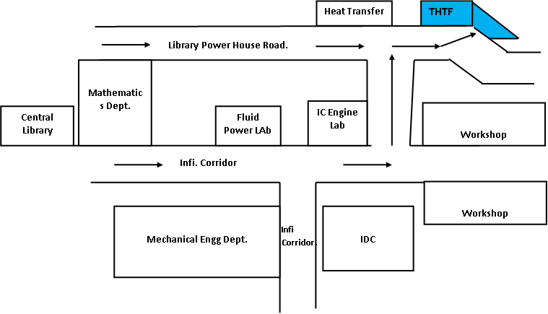
Location of Nuclear Lab (THTF)

Slide 4
Nuclear Engg. Lab Policy
You are expected to be in the lab before 2.00 p.m., Rain or Shine.
Coming to lab after 2.05 p.m. attracts zero marks as penalty.
All of the above shall be from the In-sem portion (75% weight).
Unauthorized absence (without prior permission except on medical grounds) will attract zero credit for that lab.

Slide 5
List of Experiments
Expt. No. | Experiment Name
1 | Thickness measurement of Plastic foil using Beta backscattering technique
2 | Measurement of ash content in coal using Beta backscattering technique
3 | Gamma ray spectrometer
4 | Measurement of Aluminium foil thickness using Beta transmission technique

Slide 6
Distribution
For In-Sem: 75%
Quiz during lab: 20%
Involvement in conduct of expt: 30%
Lab manual: 50%
For End-Sem: 25%

Slide 7
Experiments
Everyone will watch the expt. video and download the manual, read and bring it to the laboratory (Spiral bind the manual with graph sheets).
Do not mis-handle or play with the instruments or the radioactive materials. They may cause harm to you and others if you do not handle them carefully.
TAs will guide the students in experiments.
Doubts will be clarified by the TAs / Instructors.
The observations will be entered in the manual itself.
Results will be plotted suitably.
Please come with pen, pencil, eraser, scale and calculator.
Calculations using mobile phone is not allowed.
The manuals will be corrected immediately after the lab. The process will be completed by 5.00 p.m.

